Slide 1




Evolution of Glacially Derived Freshwater and Overpressure in the Massachusetts Shelf: An Integration of Geophysical and Numerical Methods
Jacob Siegel
Advisor: Brandon Dugan
August 27, 2013

Slide 2
Outline
Background and motivations
Geophysical evidence of a late Pleistocene ice sheet and ice stream
Glacially derived overpressure in 1D
Glacially emplaced freshwater in 3D

Slide 3
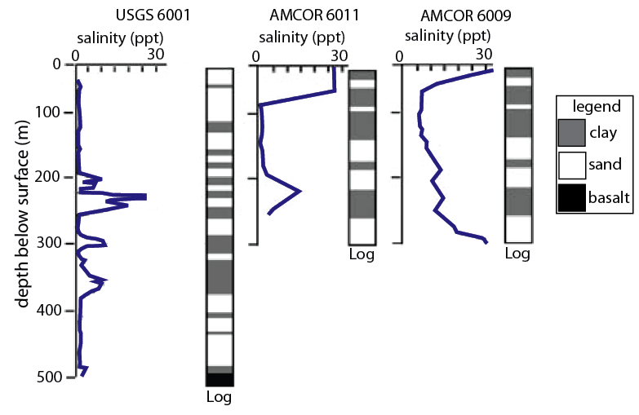
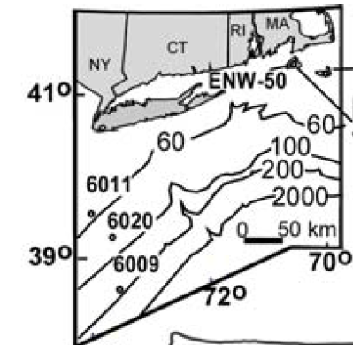
Continental Shelf Well Data
Wells on Nantucket Island and offshore New Jersey show water up to 500 mbsl and up to 100 km offshore
Source of non-renewable freshwater
modified from Marksamer et al., (2007)
modified from Hathaway et al., (1979)

Slide 4
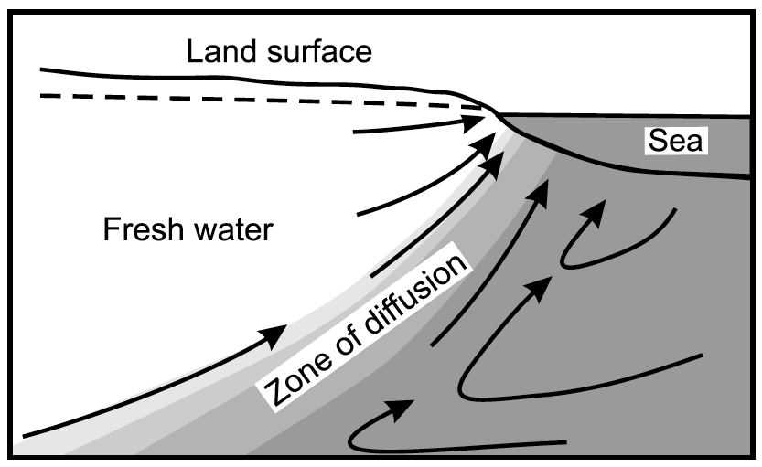
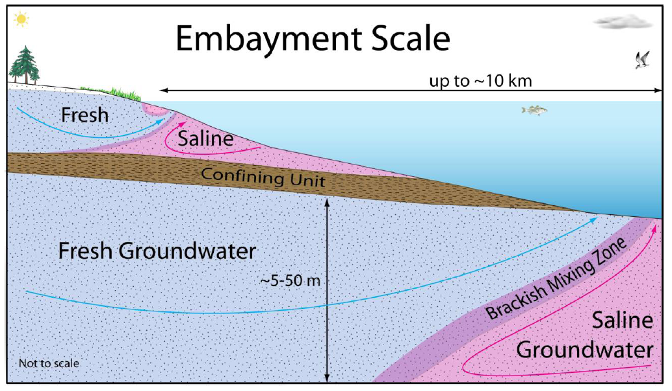
Ghyben-Herzberg Principle
Modern Flow Rates
Current flow cannot explain the offshore freshwater
(Wilson, 2005)
(Braton, 2010)

Slide 5
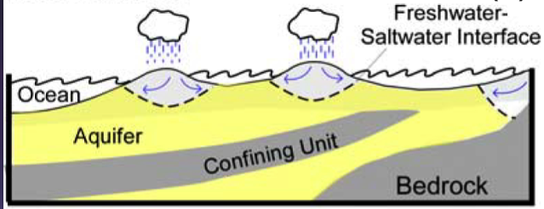
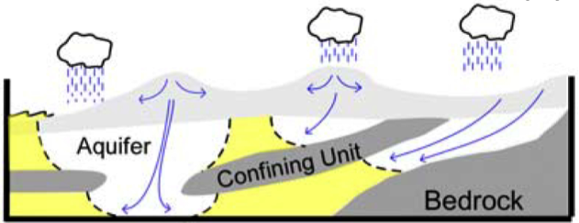
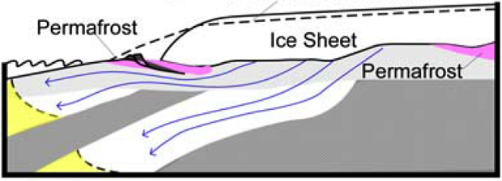
Pleistocene Influence on the Continental Shelf
Shelf experienced ice sheet loading and sea-level change throughout the Pleistocene which can emplace freshwater
shelf profile with current sea-level conditions
infiltration during sea-level lowstand
infiltration during sea-level lowstand
freshwater
saltwater
confining unit / bedrock
modified from (Marksamer et al., 2007)

Slide 6
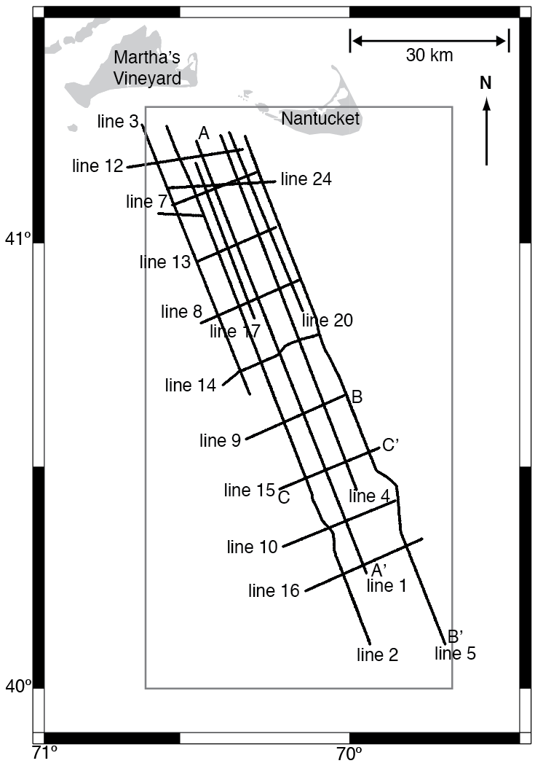
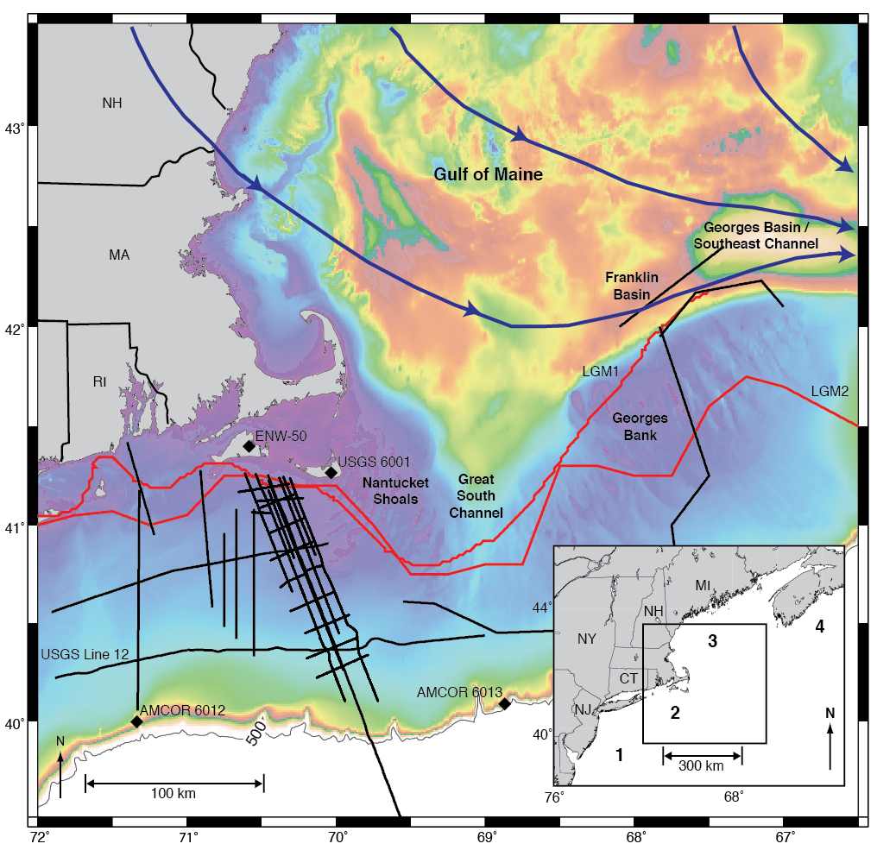
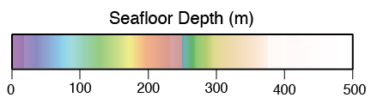
Geophysical Survey
High-resolution, multi-channel seismic survey offshore Massachusetts to understand glacial history and freshwater distribution
modified from (Siegel et al., 2012)

Slide 7
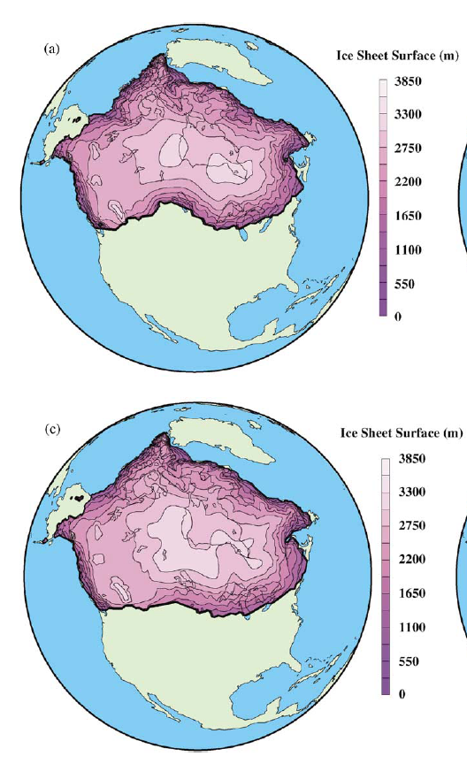
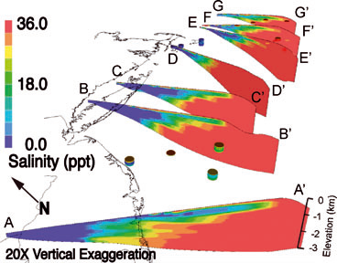
Importance of Geophysical Data
Geophysical evidence of ice sheets constrain:
Hydrogeologic models that predict the emplacement of sub-surface freshwater
Glacial models that predict the formation of Pleistocene ice sheets
Glacial Model
Hydrogeologic Model
(Cohen et al., 2010)
(Marshal et al., 2002)

Slide 8
Geophysical Evidence of a Late Pleistocene Glaciation and Paleo-Ice Stream on the Atlantic Continental Shelf Offshore Massachusetts, USA

Slide 9
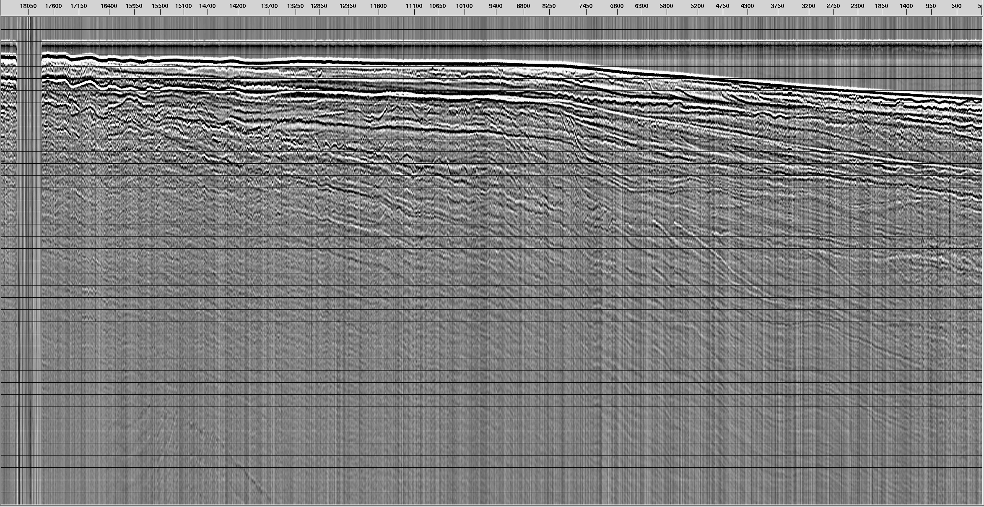
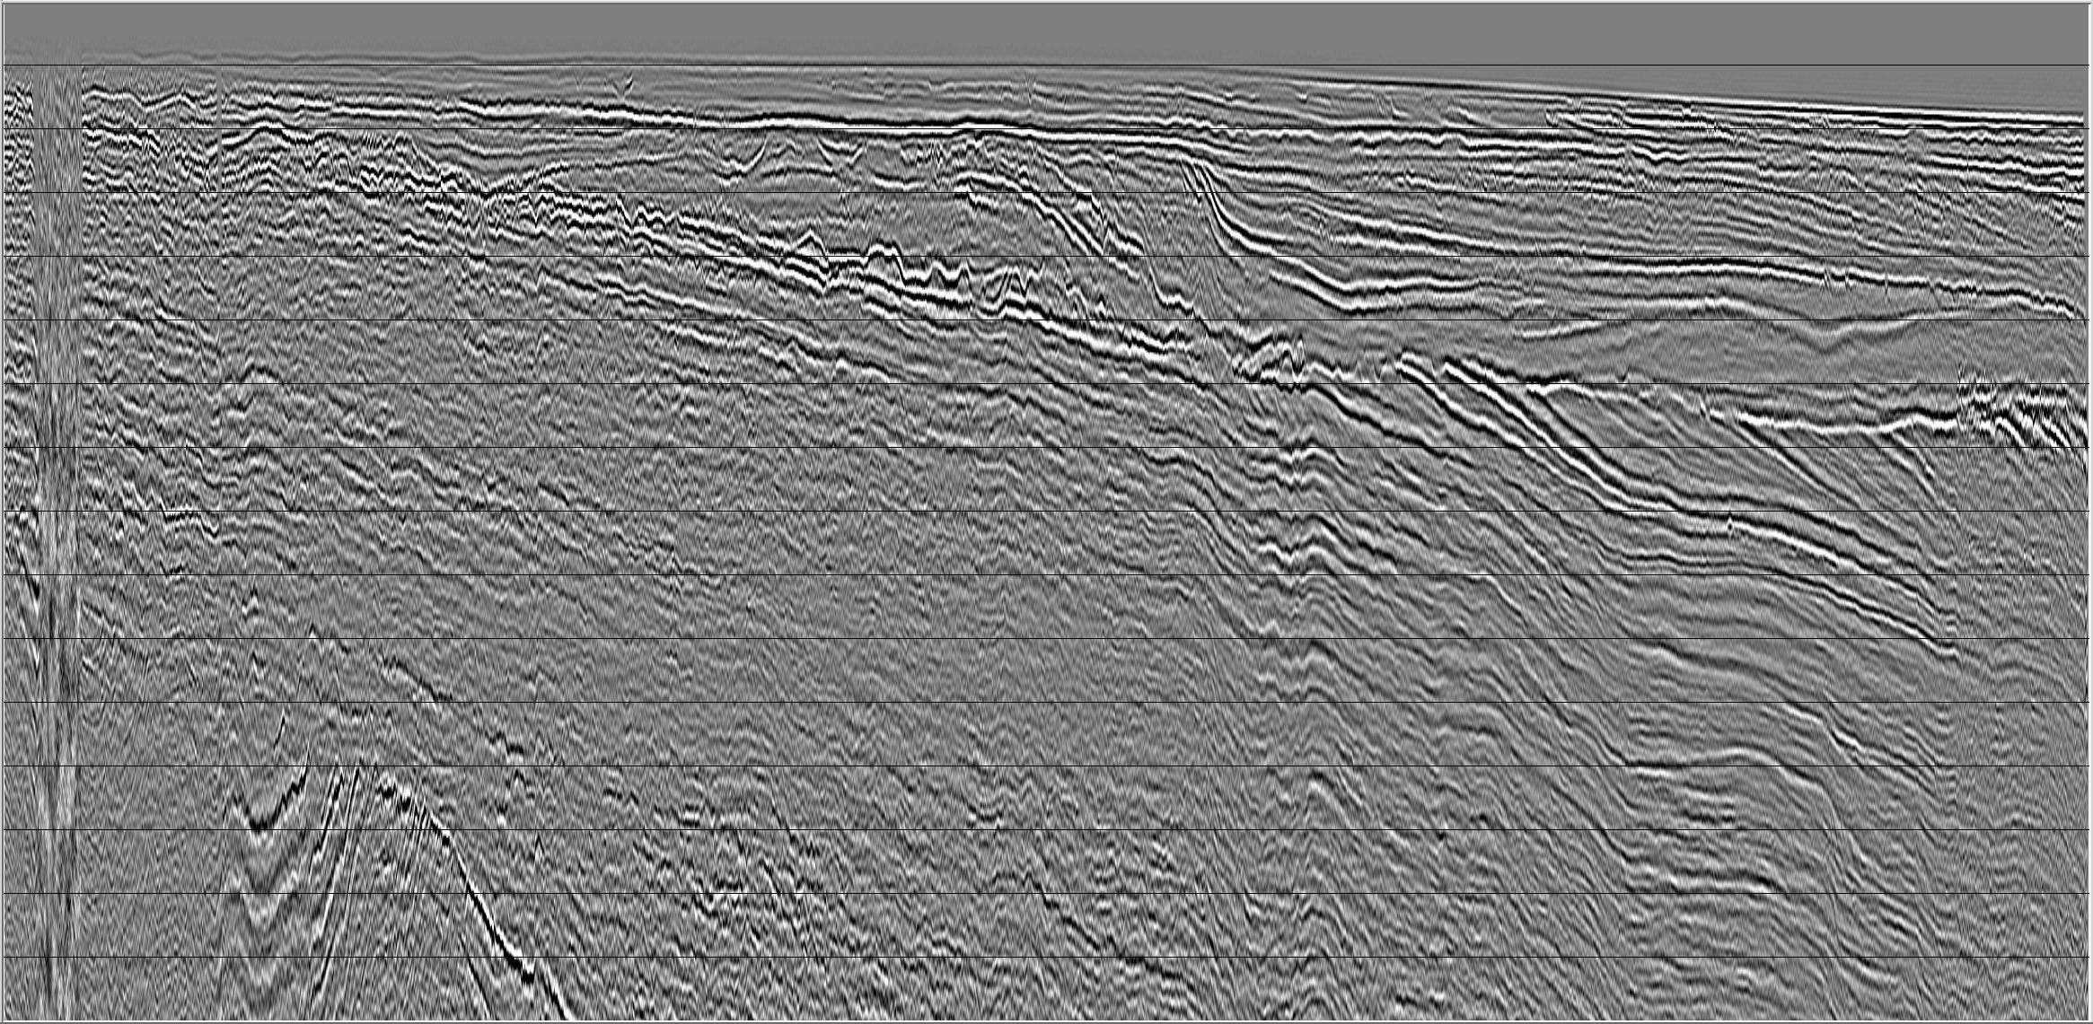
Processed Seismic Data
Unprocessed Near Channel Gather
0-
Processing:
outside trace muting
bandpass filtering
true amplitude recovery
velocity filtering (f-k and radon)
deconvolution in tau-p domain
normal moveout correction
post-stack deconvolution,
Kirchhoff PS depth migration
deconvolution in the f-x domain
time (ms)
800-
Processed Stacked Section
0-
depth (m)
vertical resolution: 4-9m
800-
25 km

Slide 10
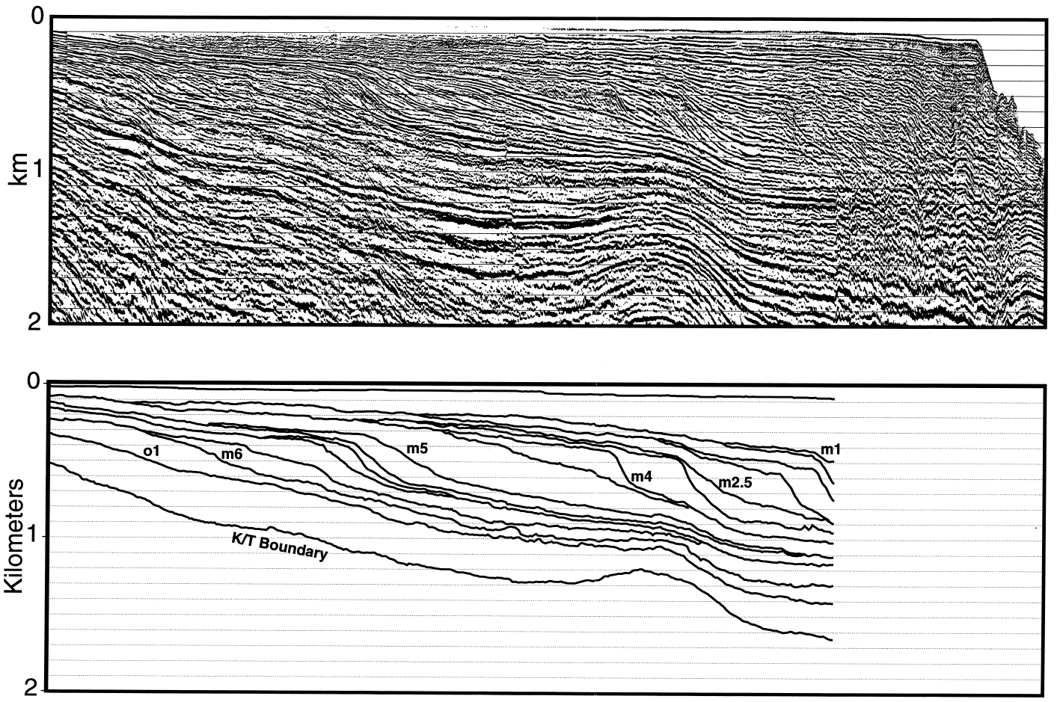
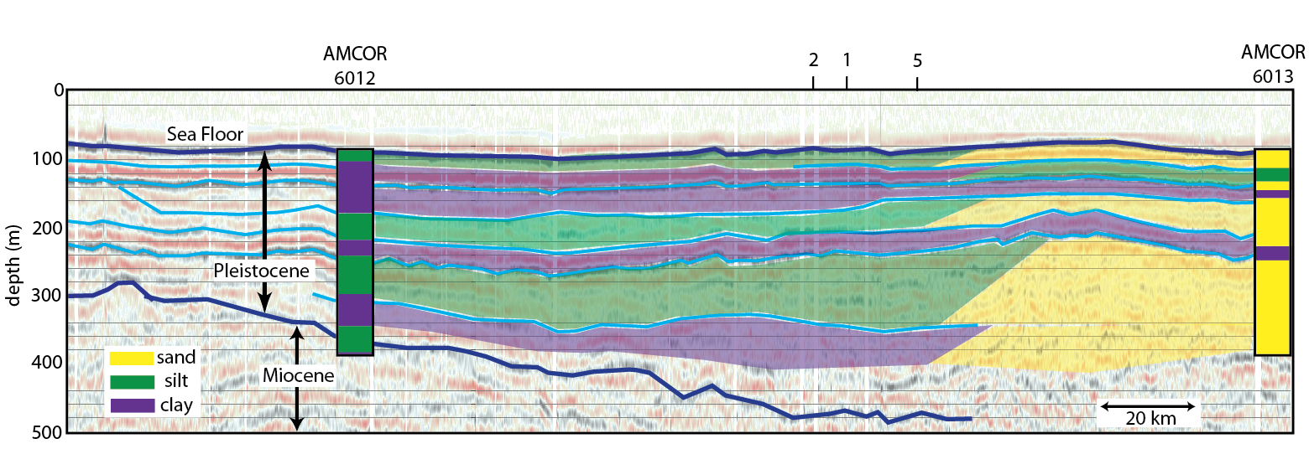
Age From Adjacent Seismic and Well Data
Pre-glacial, dated seismic data offshore New Jersey shows similar depositional patterns
AMCOR well data and USGS seismic data used to estimate base of Pleistocene
(Steckler et al., 1999)
Oligocene/Miocene:
-distinct clinoforms
Late Creations/Early Eocene:
-flat lying strata
modified from
(Siegel et al., 2012)

Slide 11
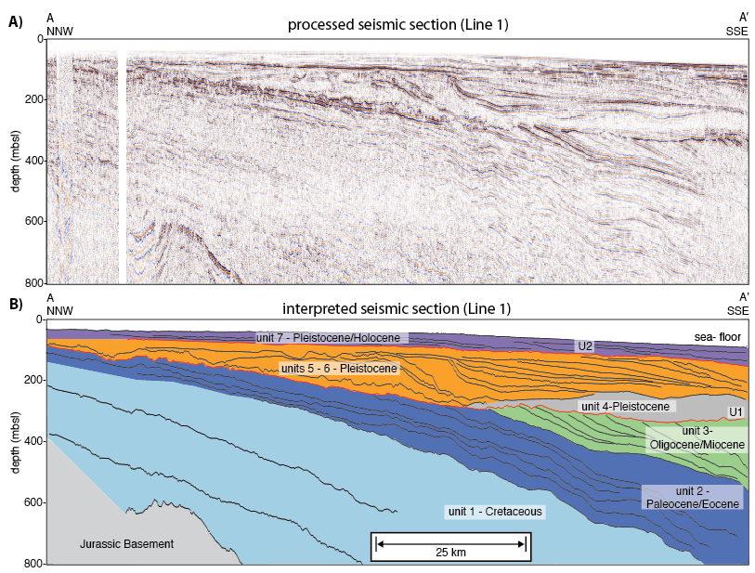
Lithology
7 depositional units, and 2 unconformities (U1 & U2)
U1 and unit 4 are considered glacial-in-origin, constrained within Pleistocene
modified from (Siegel et al., 2012)

Slide 12
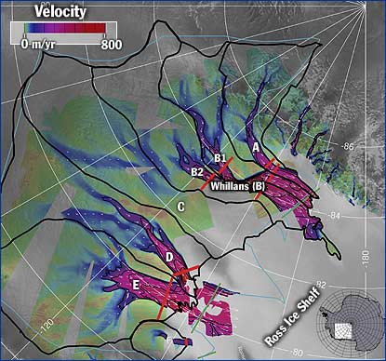
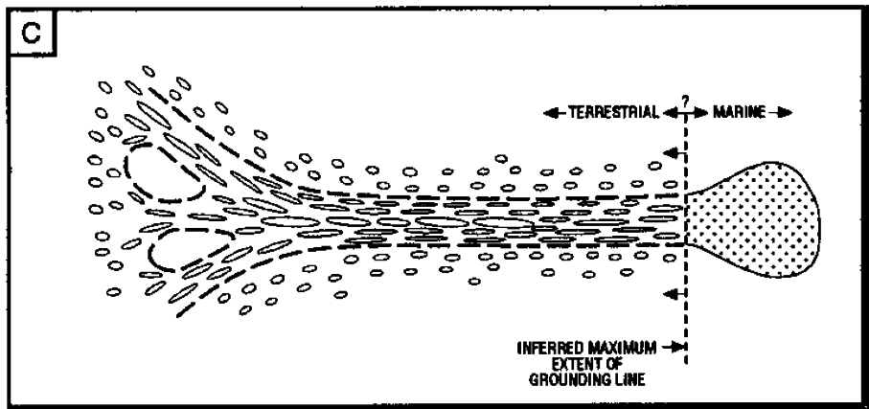
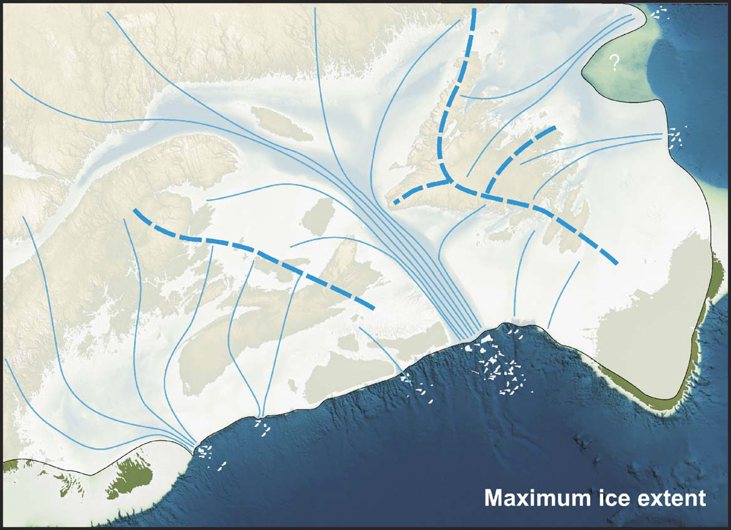
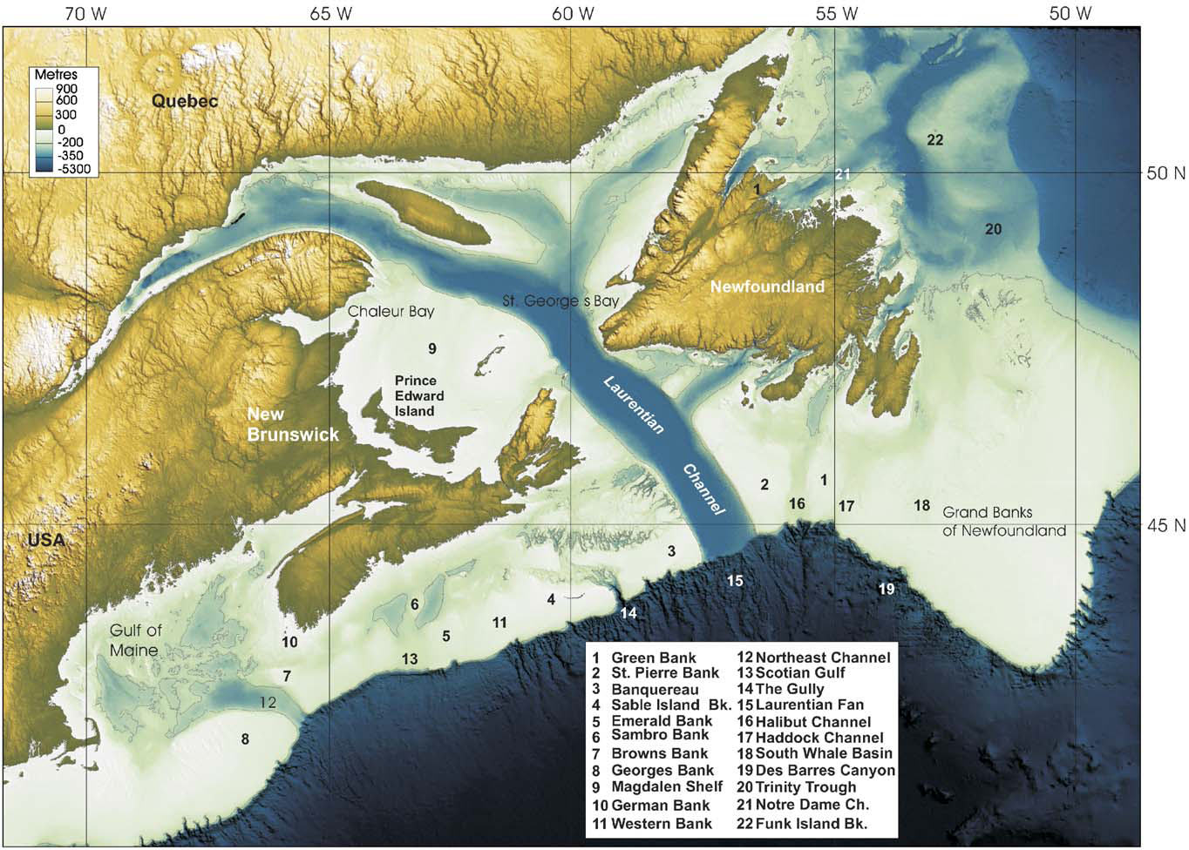
Glacial Features: Ice Stream
Area of fast moving ice within an ice sheet
(Stokes and Clark, 1999)
1) highly convergent flow patters
2) steeply eroded
edges
4) focused sediment delivery
3) characteristic shape/length (>20km wide, 150km long)
http://whyfiles.org/shorties/096ice_sheet/
(Shaw et al., 2006)

Slide 13
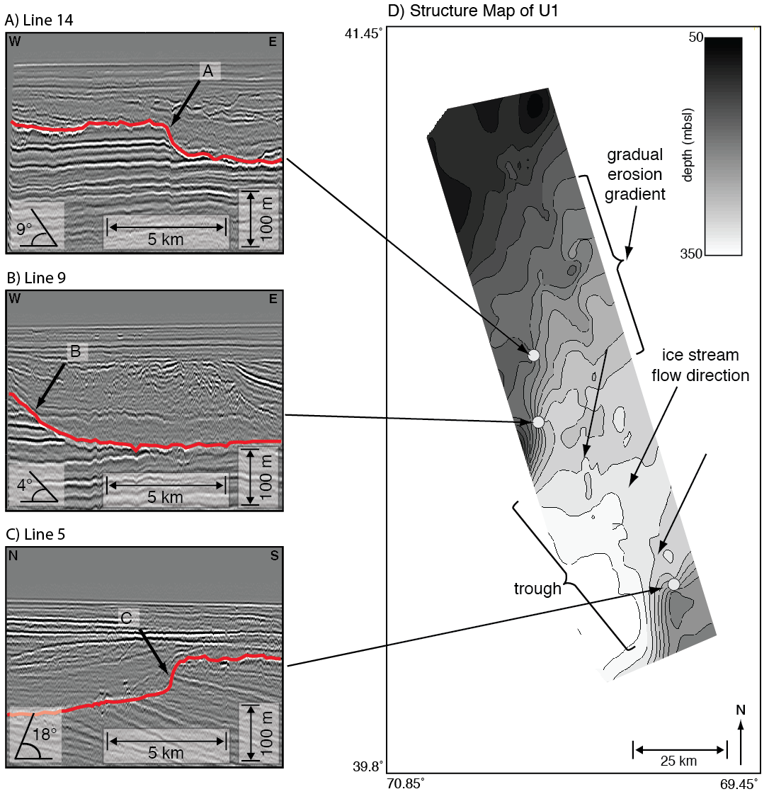
Glacial Features: Paleo-Ice Stream
steeply eroded edges
convergent flow patters
wide trough
modified from
(Siegel et al., 2012)

Slide 14
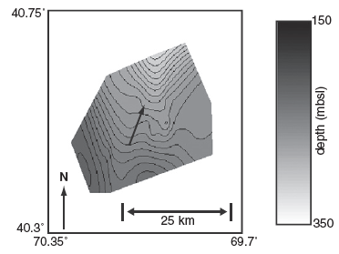
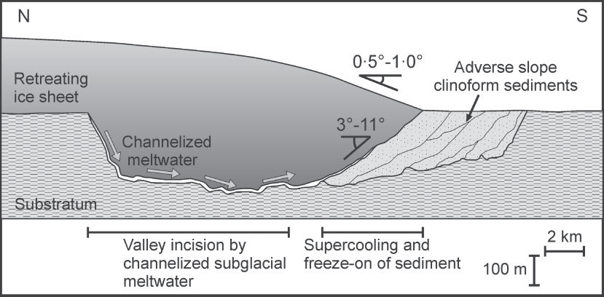
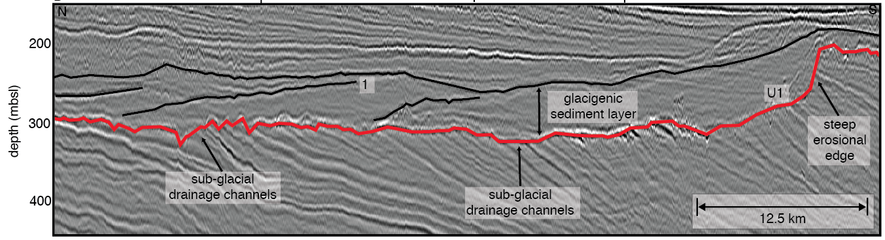
Glacigenic Sediment Layer: Glacifluvial Backfill
Channelized melt water deposit sediment to retreating ice sheet margin
Clinoforms observed dipping up valley
Structure map of back-stepping surface
North
(Kristensen et al., 2008)
South
modified from (Siegel et al., 2012)

Slide 15
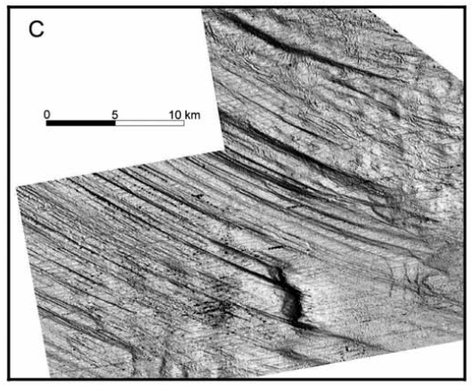
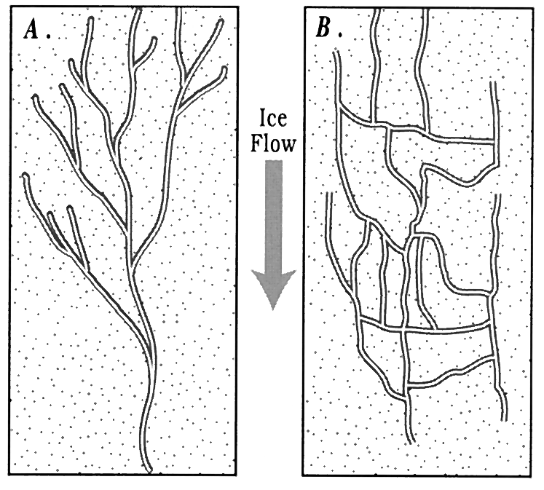
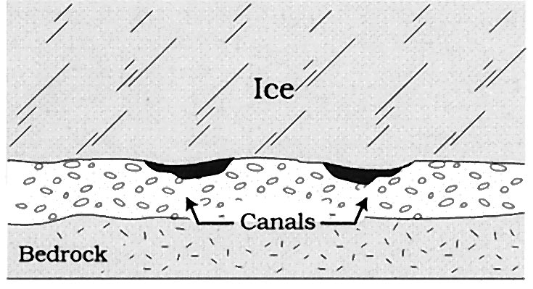
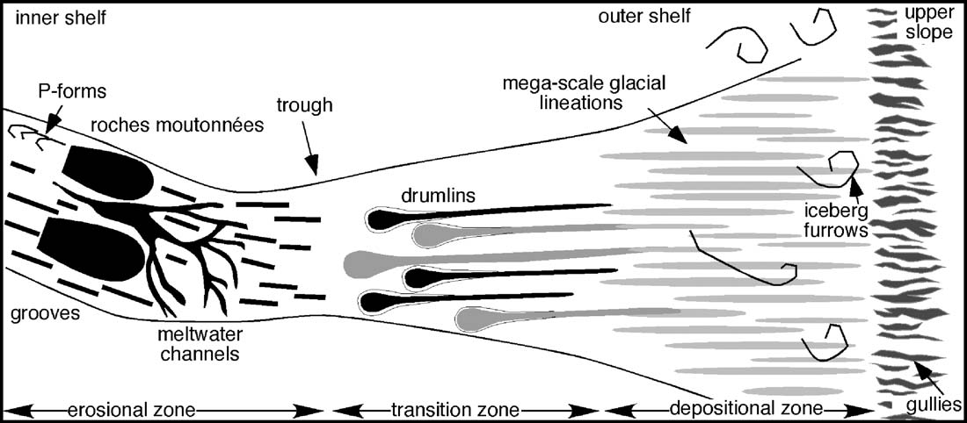
Origin of Channel Features
Channels occur mainly in trough and are likely related to process of streaming ice:
Decrease friction from basal melting -> subglacial drainage channels
Sliding from soft, deformable sediment -> mega-scale glacial lineations
Sub-Glacial Drainage Channels
Mega-Scale Glacial Lineations
Tend do be regularly spaces
Requires till or other deformable medium
Flat base from constant fluid pressure
Delivers eroded sediments
Ottesen et al. (2005)
(Clark and Walder, 1994)
(Wellner et al., 2006)

Slide 16
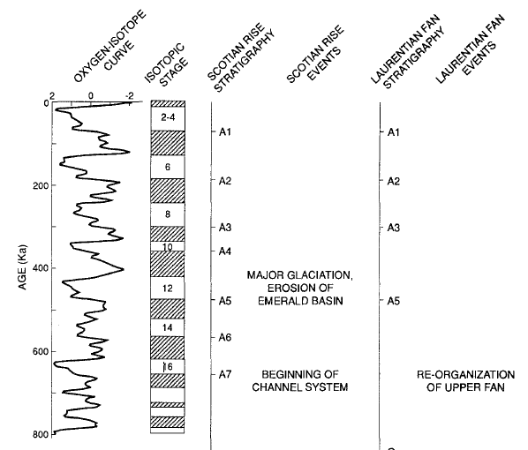
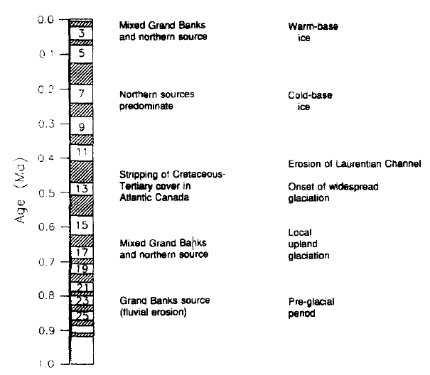
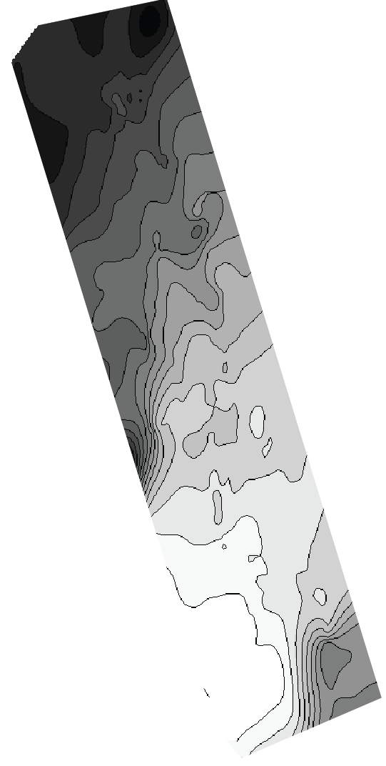
Late Pleistocene Glaciation
Glacial erosion beyond LGM ice sheet limit suggests it is related to a regional event of larger ice extent for the Laurentide Ice Sheet
Isotope stage 12 largest Pleistocene glaciations offshore southeastern Canada
Seismic Data (Berry and Piper, 1993)
Well Data (Piper et al., 1994)
modified from (Siegel et al., 2012)

Slide 17
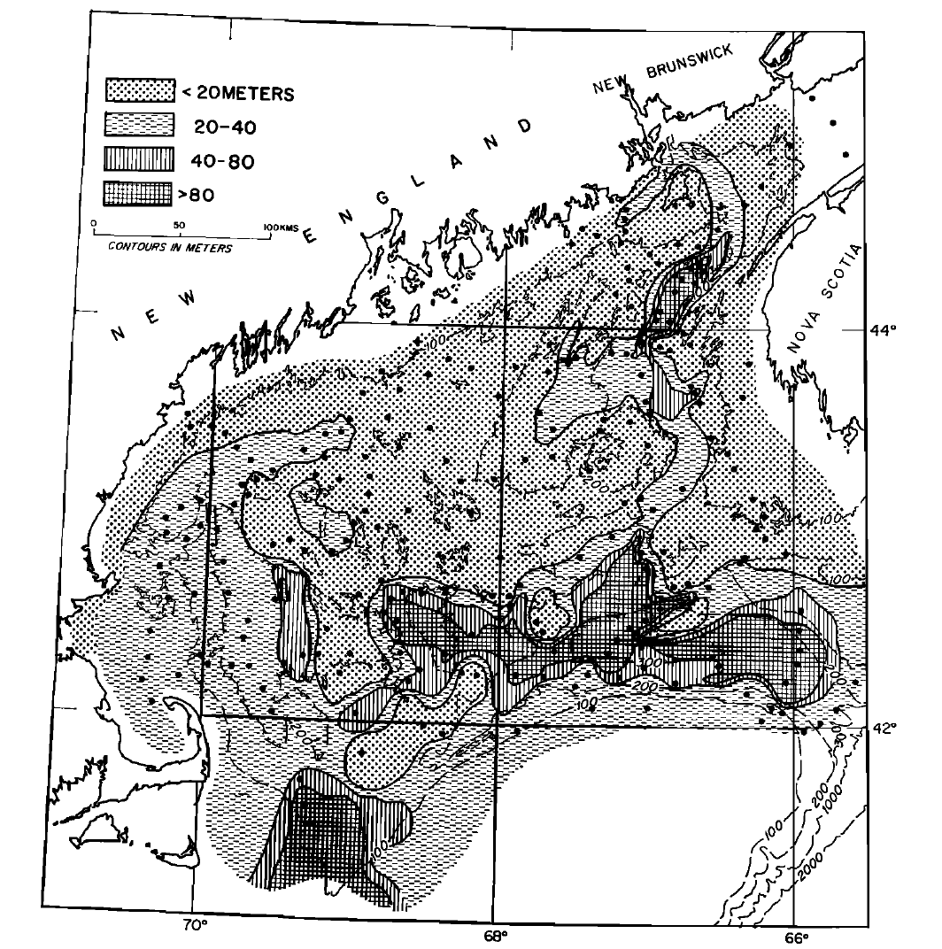
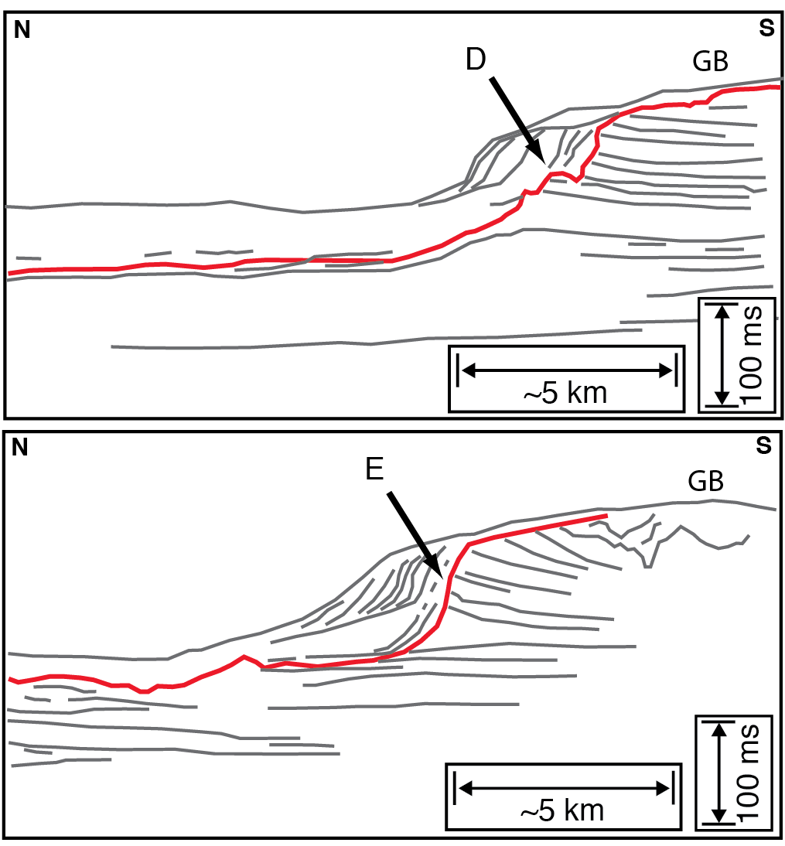
Regional Data of Pleistocene Glaciation
Trough we observe in U1 is similar in size, scale, and orientation to basins that surround Georges Bank.
Trough margin contains similar stratigraphic features to those observed on Georges Bank
Pleistocene Sediment Thickness
Pleistocene Eroded Sediment Ridges
Georges Bank
deep basins
(Schlee and Pratt, 1970)
(Knott and Hoskins, 1968)

Slide 18
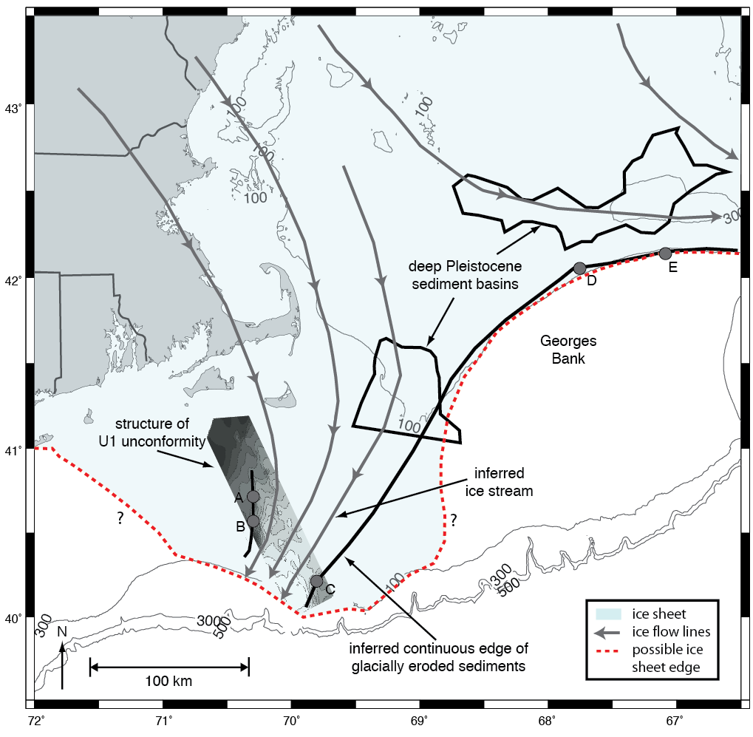
Regional Distribution of MIS 12 Ice Sheet
A similar direction of ice advance as the Laurentide Ice Sheet during the LGM
Infer an additional ice stream developed near the western edge of Georges Bank, which directed ice movement to the south
Ice sheet likely extended beyond ice stream margins towards the shelf break
modified from (Siegel et al., 2012)

Slide 19
Glacially Generated Overpressure Offshore Massachusetts, USA: Integration of Full Waveform Inversion and Overpressure Modeling

Slide 20
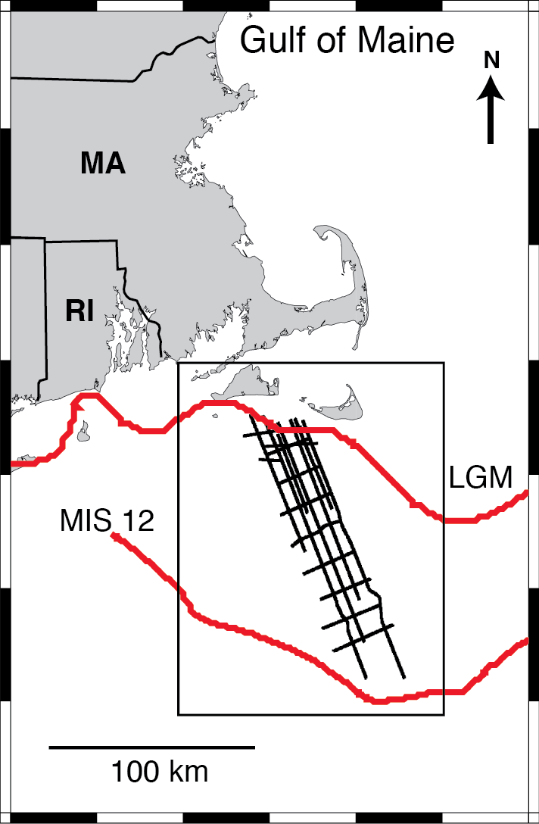
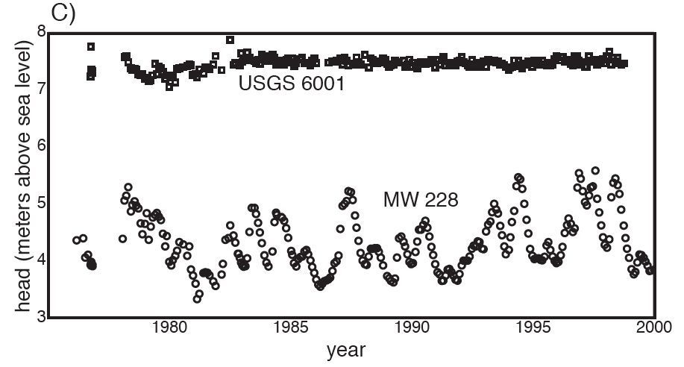
Study Region
Glacial overpressure inferred in USGS 6001 Well
43°
42°
41°
40°
72°
71°
70°
69°

Slide 21
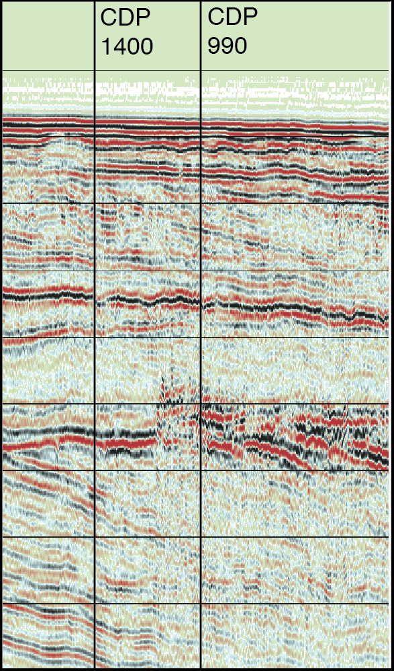
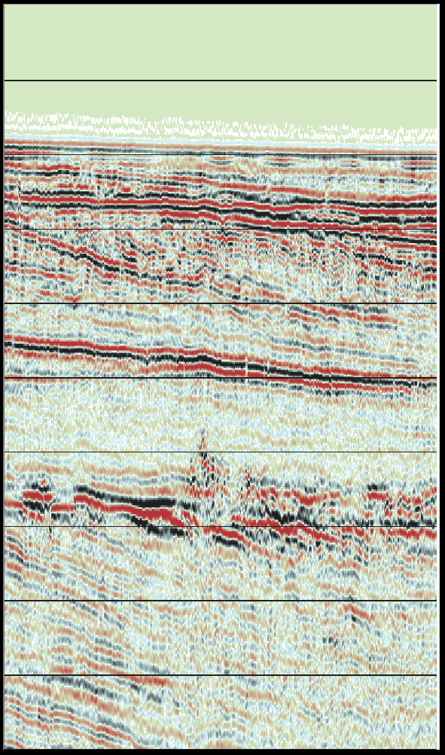
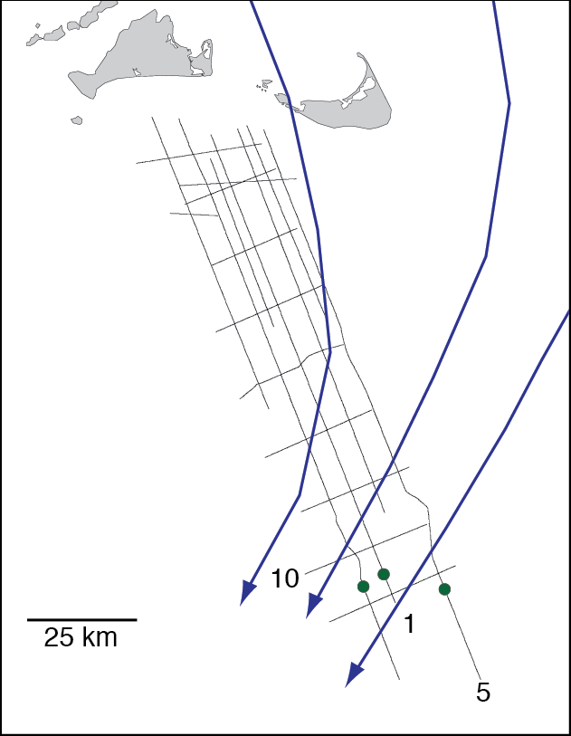
Bright Spots
Localized, high-amplitude, disturbed sediments (bright spots) occur above MIS 12 erosion surface
Line 1
Line 2
Location of Bright Spots
N
S
N
S
0-
Nantucket
100-
200-
depth (mbsl)
300-
1
25 km
2
400-
2
location of bright spots
MIS 12 ice flow direction
500-
3 km

Slide 22
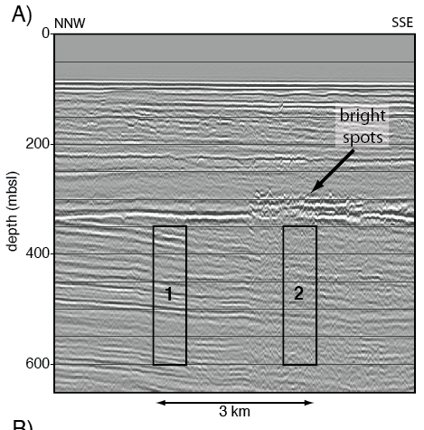
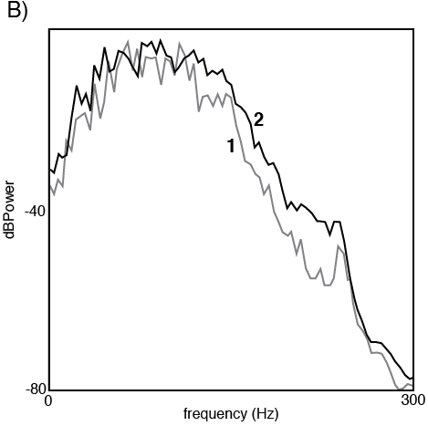
Bright Spots
No frequency-dependent attenuation beneath bright spots or bottom simulating reflector, thus they do not likely contain gas or gas hydrate
depth (mbsl)
dB Power
frequency (Hz)

Slide 23
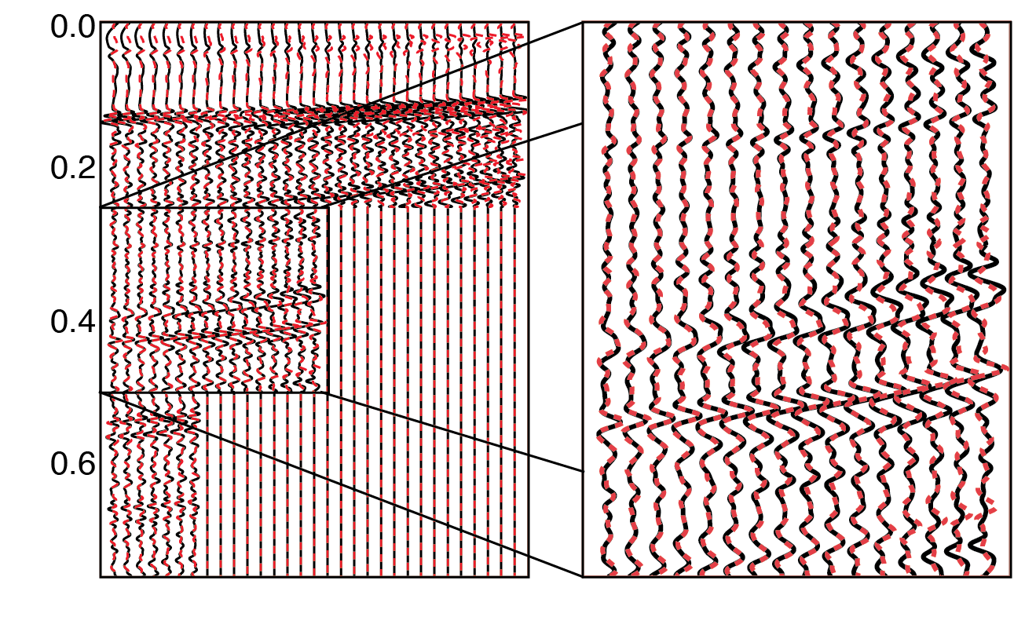
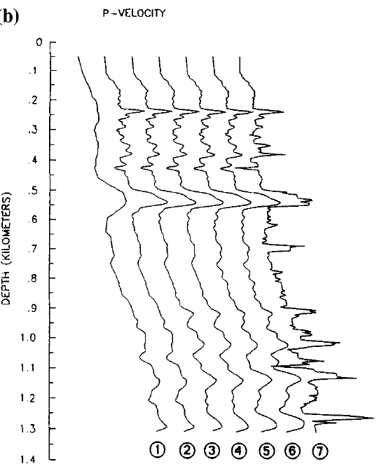
Full Waveform Inversion
Provides detailed velocity which can help estimate stress and overpressure
Iteratively updates velocity model based on synthetic wavefield
observed signal = source * subsurface-structure
Updated 1D Velocity
Observed (black) and Synthetic (red) Data
0
depth (km)
time (s)
1.5
(Kormendi and Dietrich, 1991)
0.05
0.35
P-value

Slide 24
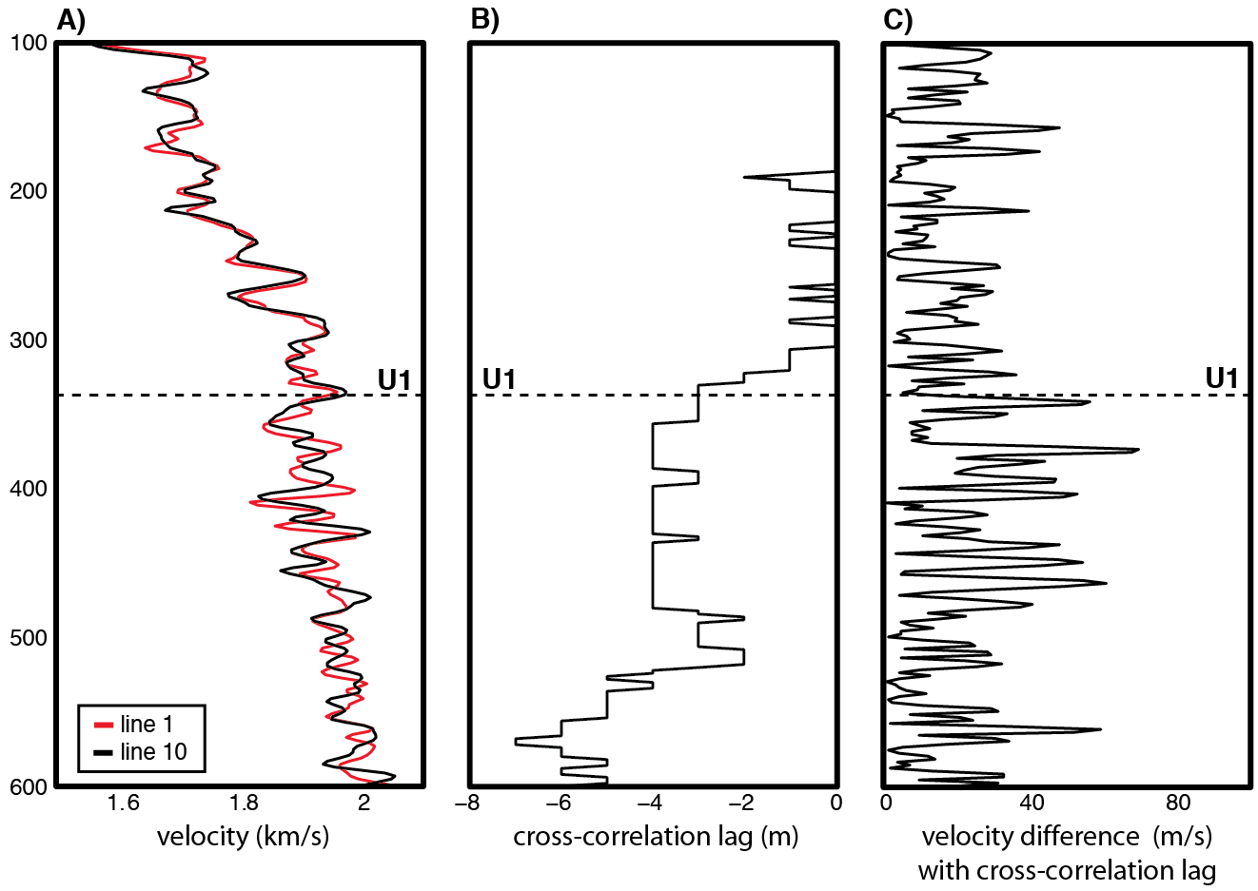
Sensitivity Test
Test limitations of 1D earth model with dipping layers to estimate model uncertainty
depth (mbsl)

Slide 25
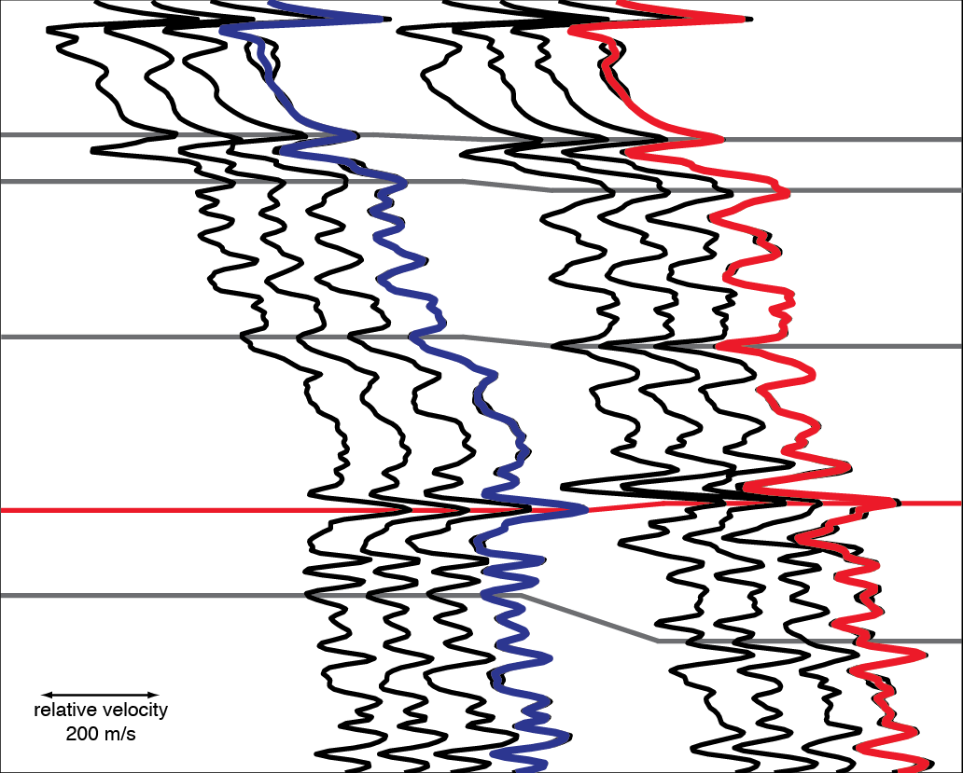
Waveform Inversion Velocity
Inversion of several adjacent CDPs are averaged to represent final velocity
190 m/s velocity difference at bright spots
1400
990
0-
seafloor
100-
200-
depth (mbsl)
300-
U1
400-
Velocity
200 m/s
3 km
500-

Slide 26
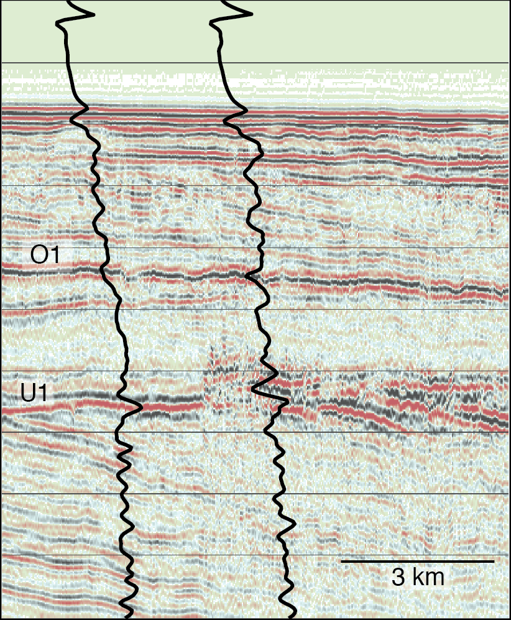
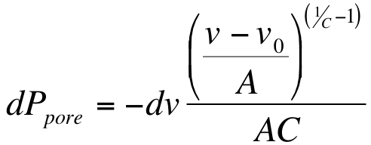
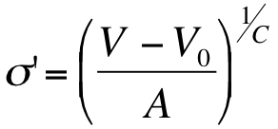
Velocity Predicted Pore Pressure
Assume major differences in velocity are from pore pressure
Bowers (1995)
Effective Stress
1400
990
S
0-
N
100-
200-
low velocity zone
difference in pore pressure with respect to velocity
depth (mbsl)
300-
400-
500-

Slide 27
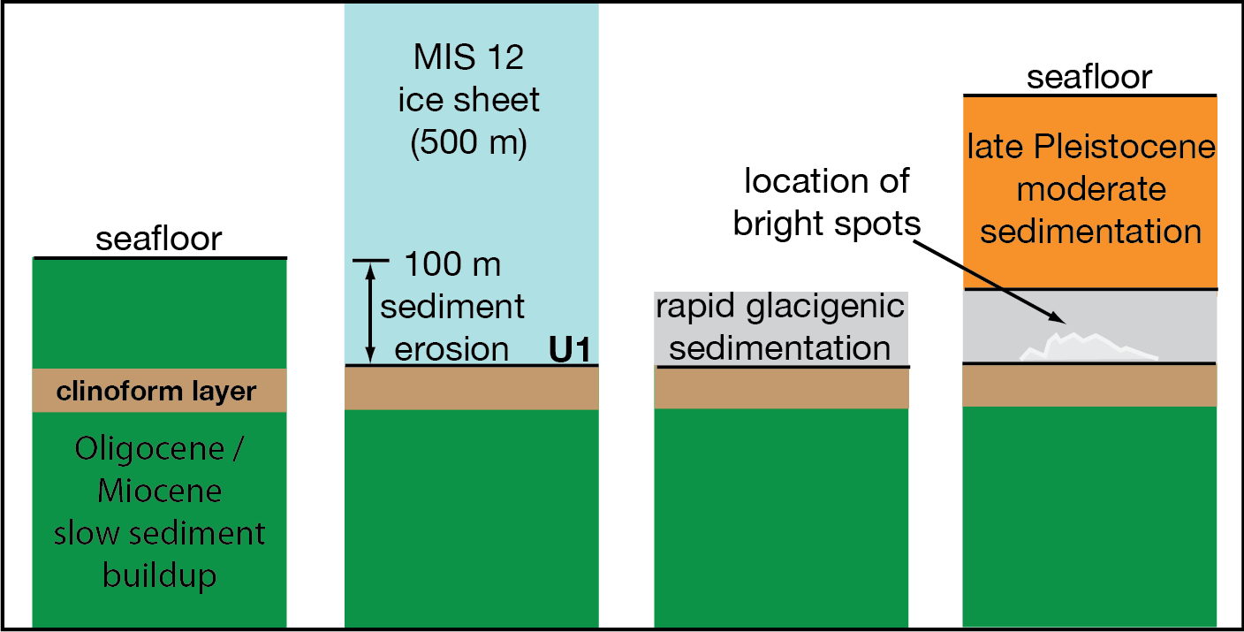

1D Fluid Flow Modeling
Used to understand origin of localized, velocity-predicted overpressure
fluid flux
of system
ice sheet weight
sediment loading
outside source
Geologic History in Model
0-
200-
depth (mbsl)
400-
600-

Slide 28


Model Predicted Pore Pressure
Mechanism beyond 1D ice sheet and sediment loading is needed to generate localized higher overpressure within glacigenic sediments
Waveform Inversion Velocity
1D Fluid Flow Model
Model Domain
0-
seafloor
100-
late Pleistocene
moderate sedimentation
lithostatic
200-
hydrostatic
source term
depth (mbsl)
300-
glacigenic sedimentation
U1
400-
source term
glacial and sediment loading
500-
0
2
4
overpressure (MPa)

Slide 29


Conceptual Models
Flow focusing - lateral migration of fluid through permeable pathways
Rapid LGM Sedimentation
MIS 12 Overpressure
surface
Extrusion moraines - deformation feature from release of glacial overpressure
sand
clay
sand
100 m
(Boulton and Caban, 1995)

Slide 30
Influence of Late Pleistocene Glaciations on the Hydrogeology of the Continental Shelf Offshore Massachusetts, USA

Slide 31




Previous Models
Person et al. (2003)
Cohen et al. (2010)
Marksamer et al. (2007)
Person et al. (2003)
Marksamer et al. (2007)

Slide 32
3D Hydrogeologic Model (PGEOFE)
Variable-density groundwater flow
Solute transport
Heat transfer
Sea-level fluctuations
Ice-sheet growth and retreat
Solves coupled equations using finite element method
Pleistocene climate as boundary conditions

Slide 33

Model Set-Up
Numerical grid based on seismic and lithologic interpretations
Horizontal grid spacing = 1-2 km, vertical = 20 – 400 m
3D grid
Model Units
Unit 7: glacial outwash
U2
Unit 6: sand, silt, clay clinoforms
Unit 5: thin clay layer
Unit 4: glacigenic sediments
U1
Unit 3: silt/clay clinoforms
Unit 2: carbonate mud
Unit 1: carbonate sandstone

Slide 34

Groundwater Flow
3D equation describing variable-density fluid flow that incorporates the effects of ice sheet loading (Cohen et al., 2010; Person et al., 2012)
Variable-density
fluid flux
ice sheet weight
η = ice sheet thickness
ρ_{i} = ice density
S_{s} = specific storage
K = hydraulic conductivity
μ_{r} = relative viscosity
ρ_{r} = relative density
u
ice
u
u

Slide 35
Solute and Heat Transport
Model solute and heat transport, use to update fluid density and viscosity
diffusion
advection
conduction
advection
change in concentration
change in temperature
Initial Condition: 35 ppt salinity
c_{s} = specific heat capacities of solid
c_{f} = specific heat capacities of liquid
ρ_{s} = densities of solid
ρ_{f} = densities of liquid
T = temperature
λ = thermal dispersion-conduction
Φ = porosity
C = solute concentration
∇ = gradient operator
t = time
D = 3D hydrodynamic dispersion-diffusion
q = specific discharge vector

Slide 36
Sea-Level Boundary Condition
Initialize the model with a sinusoidal sea-level curve for 1 Ma
Prescribe an idealized, 2 Ma Pleistocene sea-level curve
Early Pleistocene
Mid Pleistocene
Late Pleistocene
0
relative
sea level (m)
-120
3
δ¹⁸O (%)
5
Global Averaged Oxygen Isotope Curve
2
0
time (Ma B.P.)
(Lisiecki and Raymo, 2005)

Slide 37

Ice Sheet Boundary Condition
Time series of ice sheet thickness and extent that represents the late Pleistocene glacial history on the shelf
shelf crossing glaciations
(Berry and Piper, 1993)

Slide 38


Results: Sea-Level Change
18 km³ of freshwater (1.1 % of total fluid volume ) emplaced
present salinity
salinity (ppt)
20 km
average salinity (ppt)
time (Ma B.P.)

Slide 39

Results: Pleistocene Ice Sheets
35 km³ of freshwater (2.2 % of total fluid volume) emplaced by LGM ice sheet
100 km³ of freshwater (6.3 % of total fluid volume) emplaced by MIS 12 ice sheet
present salinity

Slide 40


More Freshwater Than Previous Models
Marksamer et al. (2007)
0
elevation (m)
-1
This Study
0
elevation (m)
-1
100 km

Slide 41

Results: Sensitivity Tests
Low-permeability
confining layer
109 km³ freshwater
Higher-permeability carbonate aquifer
104 km³ freshwater
Alternating layers of high and low permeability
70 km³ freshwater

Slide 42

Stratigraphy and the MIS 12 Ice sheet
Remnant overpressure after MIS 12 ice sheet retreat maintained by low permeability clinoform in Unit 3 and Unit 5
Unit 3
Unit 3

Slide 43


Effects of Seafloor Topography
Variation in salinity from 3D seafloor topography of 20 m across the northern model section
Thermally-driven convection cells: from sea-floor relief which causes isotherms to dip

Slide 44
Conclusions
Geophysical evidence of MIS 12 ice sheet offshore Massachusetts
Constrains ice sheet models
Glacially-derived overpressure
Could be contributing to submarine groundwater discharge offshore
Glacially-emplaced freshwater up to 30 km beyond Nantucket Island
Potential, non-renewable resource
43°
42°
41°
40°
72°
71°
70°
69°
100 km

